Slide 1
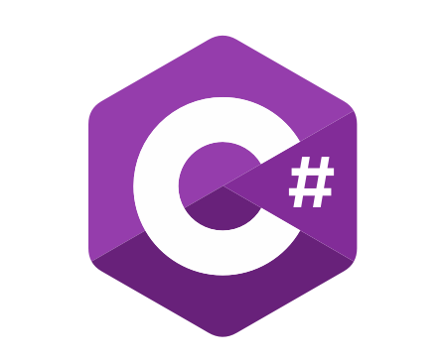
C# OOP
Course Introduction
SoftUni Team
Technical Trainers
Software University
https://softuni.bg/

Slide 2
Table of Contents
Course Objectives
Training and Team
Course Organization
Course Infrastructure
Evaluation Criteria

Slide 3
Have a Question?
sli.do
#csharp-advanced

Slide 4

Course Objectives

Slide 5
Why OOP?
Object-oriented programming is an important paradigm
Anyone involved in software development should be familiar with OOP and OO modelling
All modern languages are either object-oriented or support classes and objects
Modern frameworks, libraries and APIs are object-oriented
OOP is a basic requirement for starting a job as developer

Slide 6
Practical Exam
2 practical problem for 4 hours:
Create a simple project that:
Follows the OOP principles
Implements functionality based on a description
Test a provided class
Automated judge system with real-time feedback
Upload a zip project to the judge system

Slide 7

Exam Demonstration

Slide 8

The Team

Slide 9
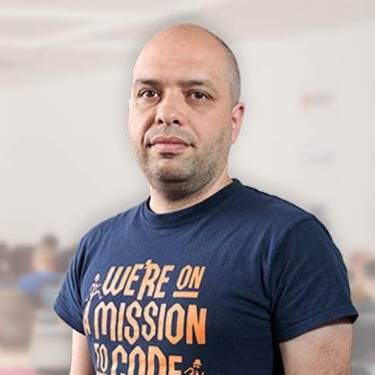

Stamo Petkov
Head Of Department at Information Services Plc.
Worked with various technologies
.NET and C#, BASIC, Pascal, Object Pascal, PHP
More than 15 years of experience
Experienced Lecturer

Slide 10
INFORMATION SERVICES
Key partner of the state institutions in the implementation of ICT projects
The Ministry of Finance
The National Revenue Agency
The Customs Agency
The Ministry of Regional Development and Public Works
The first governmentally approved provider of qualified certification services in Bulgaria
https://www.is-bg.net/bg/

Slide 11
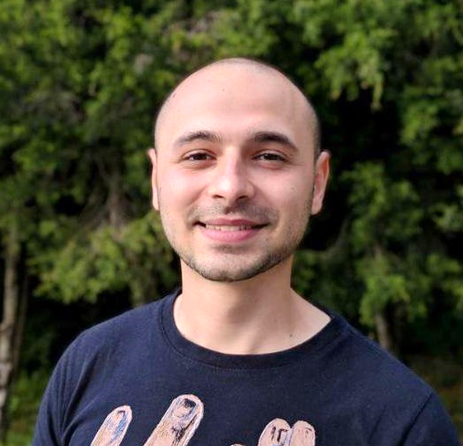
Stoyan Shopov
Team Lead @ SoftUni
Technical Trainer @ SoftUni
ASP.NET Web Developer
Experience with WebForms & WPF
Mountain lover

Slide 12
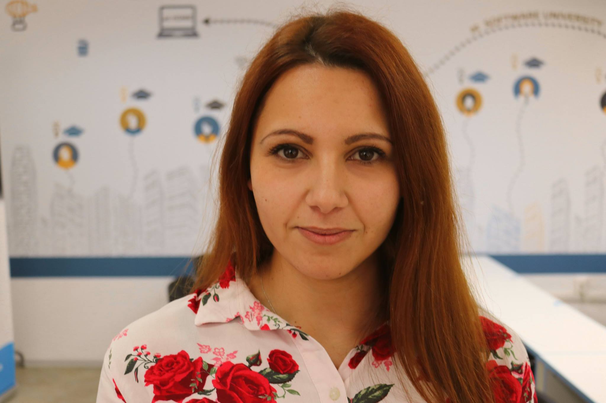
Mariela Petrova
C# Advanced Team Lead
Technical Trainer @ SoftUni
Interested in web development with ASP.NET Core
Contacts:
m.petrova@softuni.bg

Slide 13

Course Organization

Slide 14
Course Information
7 weeks / 4 times a week
15 Credits
Time frame
28 June 2019 – 15 August 2019
Exam
11 August 2019 – 09:00
Retake
15 August 2019 – 09:00

Slide 15

Homework Assignments & Exercises
Your homework is mainly work in class
Lesson days → slides + live demos + exercises
Exercise days → only exercises
How to submit your homework?
Submitted in the judge system
Do your homework when it's due
Assignments pile up quickly

Slide 16


Scoring System for the Course
Mandatory:
Final exam – 95%
Exercises & homework – 5%
Bonuses:
Presence in class – 5% bonus
Forum activity – bonus up to 5%

Slide 17



Course Web Site, Forum and FB Group
Official web site:
Official discussion forum:
Official Facebook group:
softuni.bg/C#OOP-June-2019
softuni.bg/forum/C#Advanced
facebook.com/C#Advanced-May-2019

Slide 18
https://softuni.bg/csharp-oop

Slide 19












SoftUni Diamond Partners

Slide 20




SoftUni Organizational Partners

Slide 21




Trainings @ Software University (SoftUni)
Software University – High-Quality Education and Employment Opportunities
softuni.bg
Software University Foundation
http://softuni.foundation/
Software University @ Facebook
facebook.com/SoftwareUniversity
Software University Forums
forum.softuni.bg

Slide 22

License
This course (slides, examples, demos, videos, homework, etc.) is licensed under the "Creative Commons Attribution-NonCommercial-ShareAlike 4.0 International" license

